Slide 1
Mobile Number
Enter OTP
Sign In
OTP not received? Resend
You don’t have an account?
Sin up as
Parent
Child
Continue

Slide 2
Sign up as a PARENT
Sign up as a CHILD
Photo
Photo
ID Number
Name
Name
Mobile Number
Mobile Number
Verify
Verify
Sign Up
Sign Up

Slide 3
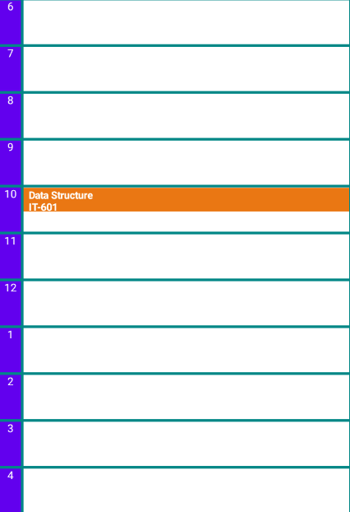













Child app
My Family
Maria
Location History
Realtime Tracking
My Family
Alerts
Geofence
Agenda
Message
Pedometer
Settings
Jhon
Maria
Ted
Becky
Torres
Grande Mosque Parise
Michel Attenuate
08:20 Am
SOS
+
My Family
3
3
Settings
Today, 18 Jan
Alerts
Pedometer

Slide 4



Alerts
Geofence
Add
Geofence
Done
Clear All
Home*
Type address here
X
Becky is leaving home
02/01/2022 08:00 Am
School *
Jhon is arriving at home
02/01/2022 08:30 Am
It’s time to go shopping
02/01/2022 09:30 Am
Place Name
Address
Add
My Family
Alerts
3
My Profile
My Family
3
My Profile
Pedometer
Geofence
Pedometer

Slide 5



Agenda
Add
Pedometer
00:50:25
Geofence
Mon | Tue | Wed | Tr | Fri | Sat | Sun
Type address here
X
Set
1,090
Steps
Shopping super market
2,000
1,090
Kcal
Km
Meeting friends
Start
Agenda
History
Date
Add
02/012022
02/212022
My Family
Agenda
3
My Profile
My Family
3
My Profile
Pedometer
Geofence
Pedometer

Slide 6
Board
Add
Shopping super market
Meeting friends
Agenda
Date
Add
My Family
Agenda
3
My Profile
Pedometer

Slide 7
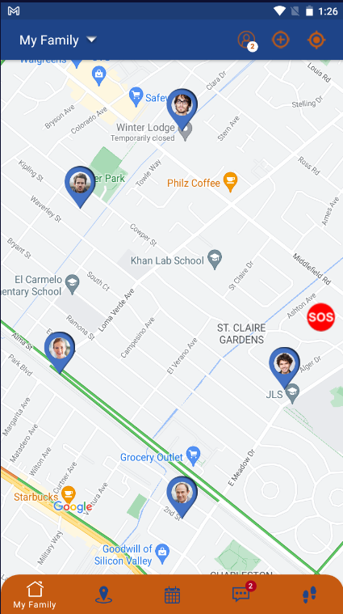


request
Dad
Mom
accept
Maria
Ted
Dad, Mom
Child1, Child2
request
Dad, Mom, child1, child2

Slide 8
Dashboard
Users
Families
Users
50,000
12,000
Map

Slide 9
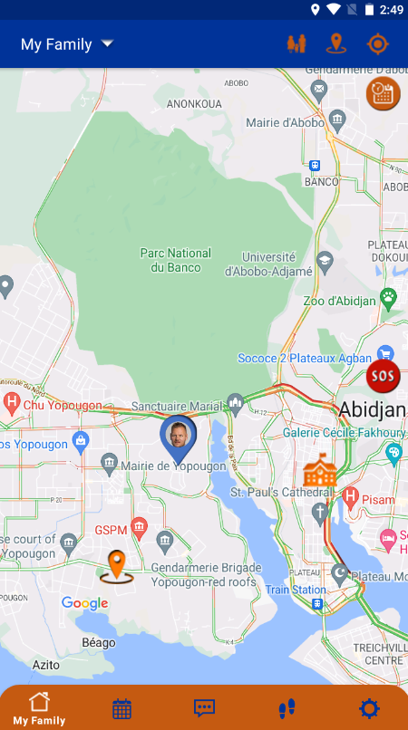



Add
Add
Threat1 description1 here..
…
Created by Jhon, 03/01/2022
Updated by Jhon, 03/11/2022
Add new security threat
Threat1 description
Confirmed by Maria, 03/12/2022
Description
Confirmed by Juan, 03/13/2022
Threat1 description2 here..
…
Place
Threat address here from map
Add

